Slide 1
How To Run CUDA C/C++ on Jupyter notebook in Google Colaboratory

Slide 2
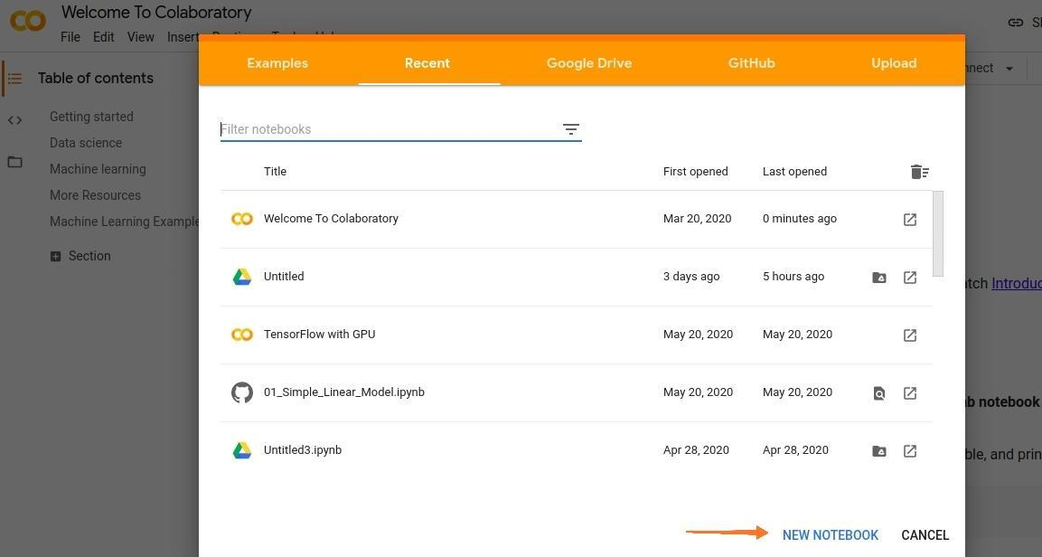
Step 1: Go to https://colab.research.google.com in Browser and Click on New Notebook.

Slide 3
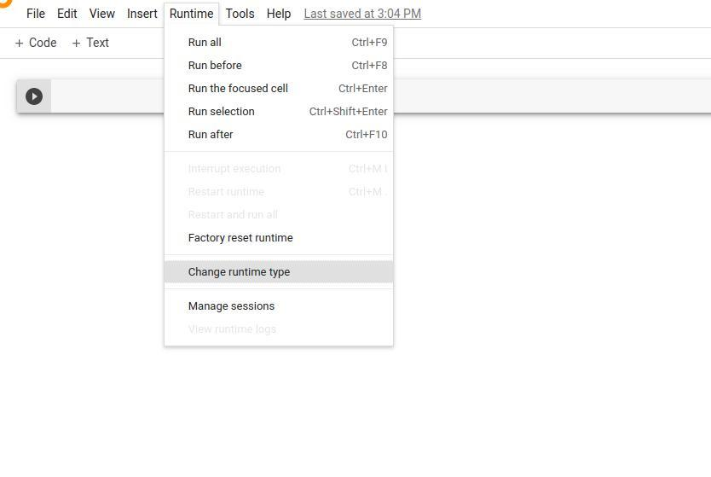
Step 2: We need to switch our runtime from CPU to GPU. Click on Runtime > Change runtime type > Hardware Accelerator > GPU > Save.

Slide 4
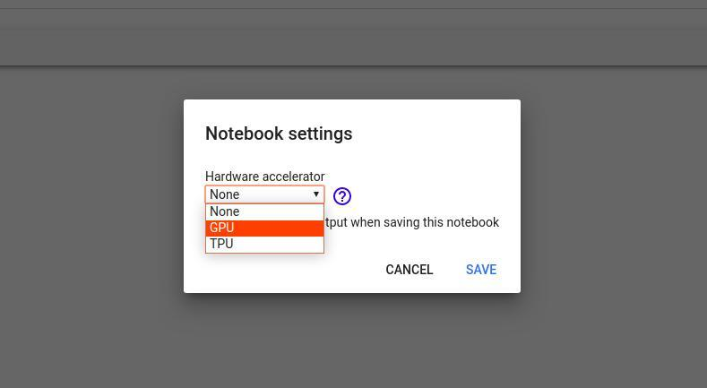

Slide 5
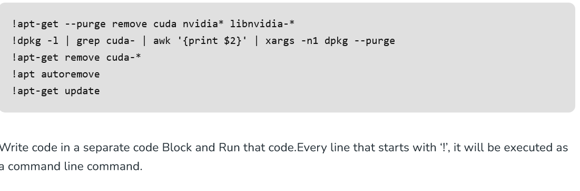
Step 3 (no longer required): Completely uninstall any previous CUDA versions.We need to refresh the Cloud Instance of CUDA.

Slide 6
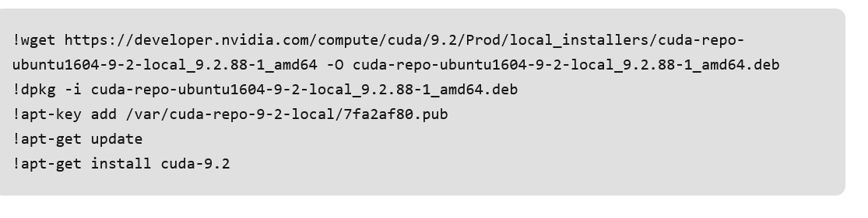
Step 4 (no longer required): Install CUDA Version 9 (You can just copy it in separate code block).

Slide 7
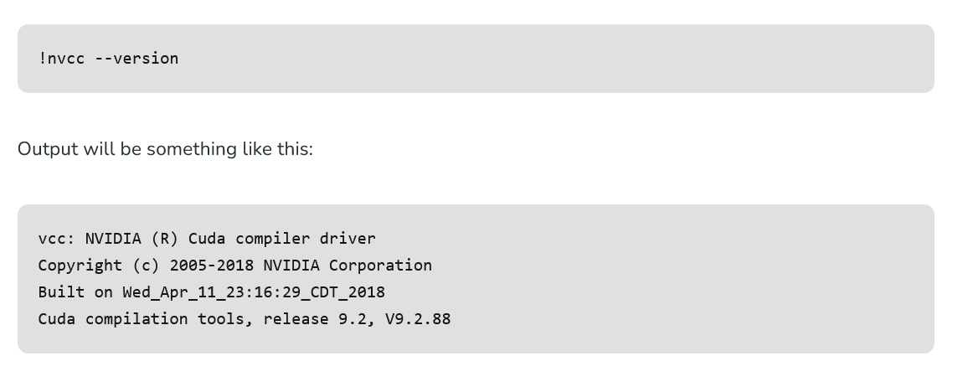
Step 5: Now you can check your CUDA installation by running the command given below :

Slide 8

Step 6: Run the given command to install a small extension to run nvcc from the Notebook cells.

Slide 9
Step 7: Load the extension using the code given below:

Slide 10
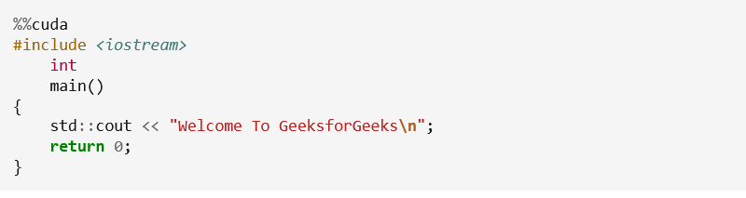
Step 8: Execute the code given below to check if CUDA is working or not.
Important Note: To check the following code is working or not, write that code in a separate code block and Run that only again when you update the code and re running it.

